Slide 1
Resistance

Slide 2
By the end of this lesson, you will be able to:
Define resistance.
Explain how the resistance of an object can be changed.
Describe the function of resistance in a circuit.

Slide 3

We’ve seen so far that current is a measure of the flow of charge (electrons).
However, it would be unrealistic to assume that this flow is smooth and unhindered. Just as we experience friction when sliding across the floor, just as water experiences drag when flowing through the pipes, current too experiences a hindering force. This force is intuitively named resistance.
All components in a circuit, including the wire, carry resistance. In some cases, we may want to minimise resistance; in others, we may want to maximise it.

Slide 4
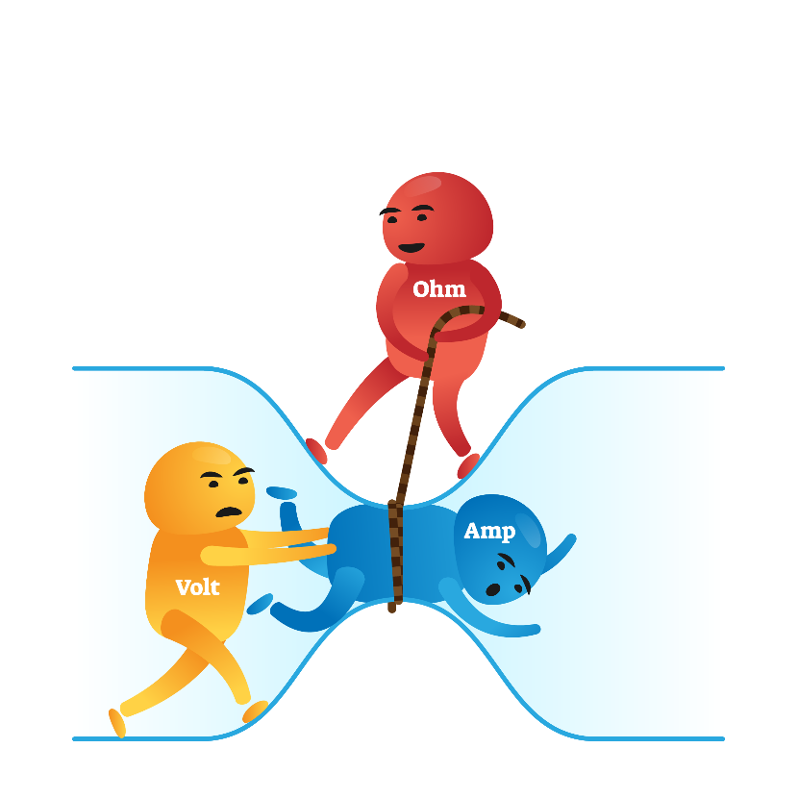
A more technical definition for resistance would be “a measure of how difficult it is for current to flow through a given component.”
The higher a component’s resistance, the more difficult it is for current to flow through it. Conversely, the lower a component’s resistance, the easier it is for current to flow through it.
If you know much about conductance, you may have quickly realised that resistance and conductance are polar opposites. Whereas resistance refers to obstacles to flow, conductance refers to ease of flow. Naturally, this means that they have an inversely proportional relationship: when one is high, the other is low.

Slide 5
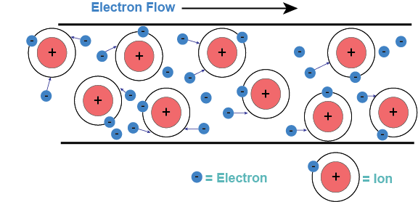
So far, so good, but what causes resistance?
We know that an electrical current refers to the flow of delocalised electrons through a circuit. Aside from these electrons, ions make up the circuit and its components.
Every time an electron encounters an ion, it loses energy and slows down. This is also known as a voltage drop. Components with high resistance often have more ions, so there is a higher probability of an encounter, or even a collision.

Slide 6
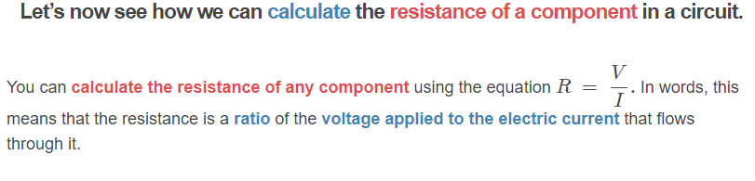
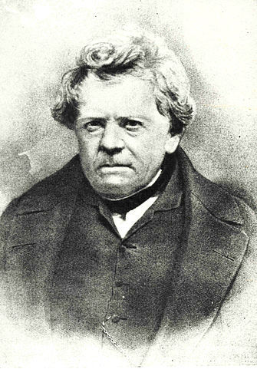
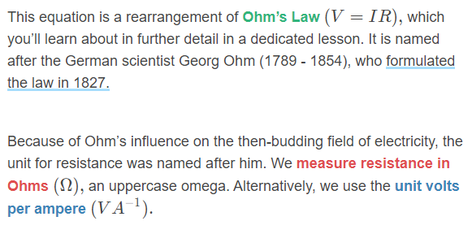

Slide 7
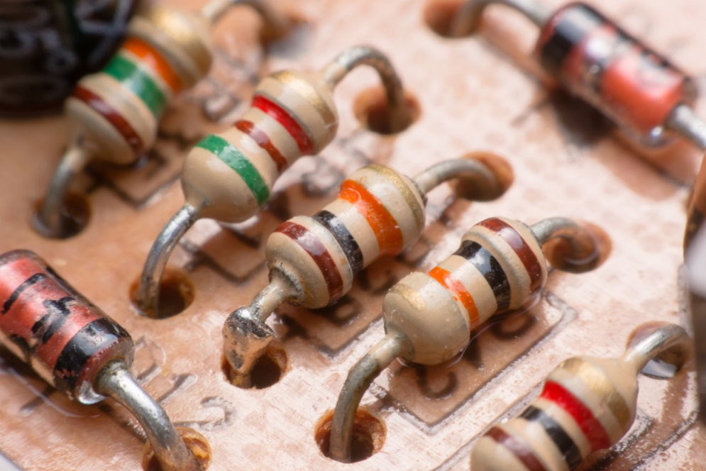
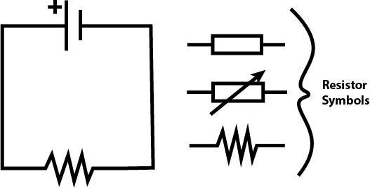
We can increase the resistance of a circuit by adding a resistor component.
Resistors are typically made from semi- or non-conductive materials, such as carbon; others use coils of metal alloys such as nichrome, while others yet use a glass tube with a thin inner metal coat.
The resistor’s symbol in a circuit diagram is a zagged line. You may also see a rectangular box as an alternative.

Slide 8
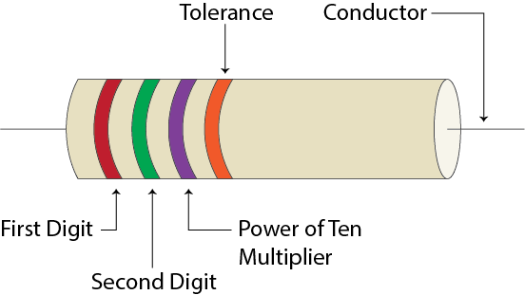
Resistors come with different resistances, but how can we tell when they’re smaller than a pea?
Large resistors can simply have their resistance printed on, but others are so small that you couldn’t possibly read such small numbers even when squinting. Instead, many resistors are colour coded with four different bands.
If we positioned our resistor so that the band closest to the edge was on the left, we could then interpret the resistance:
The first two bands represent digit values.
The third band represents a multiplier in the power of tens.
The fourth band represents the manufacturing tolerance.

Slide 9
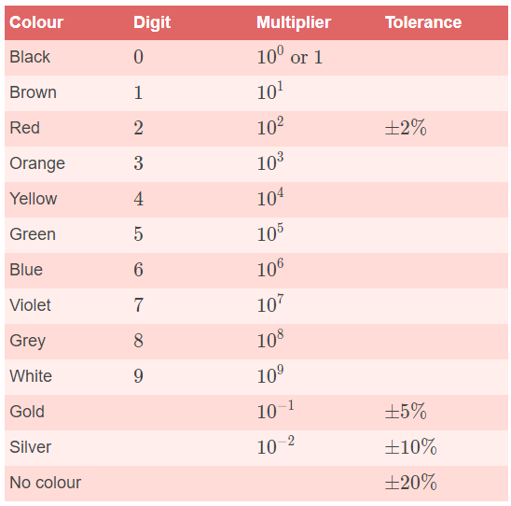
The following table shows the colour coding system for resistors:
For example, a resistor with a resistance of 35×10¹ Ω and a tolerance of 10% would have four bands coloured as follows;
First band; Orange
Second band; Green
Third band; Brown
Fourth band; Silver

Slide 10
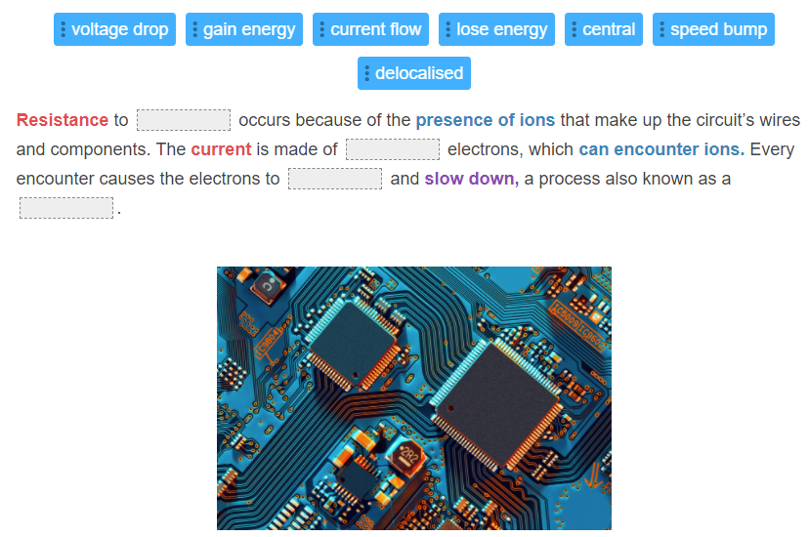

Slide 11
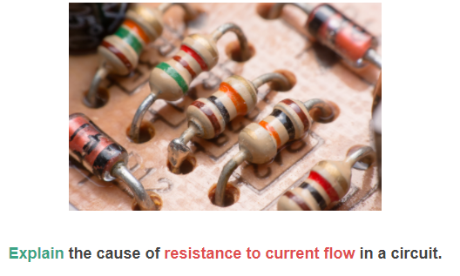

Slide 12
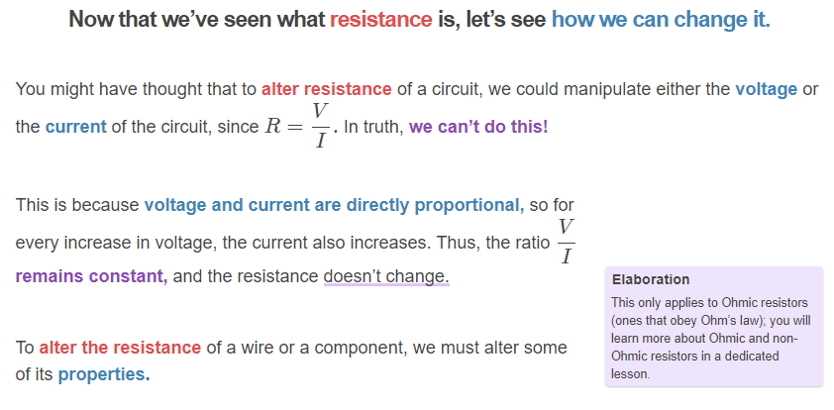

Slide 13


There is a different equation that relates the resistance of a component to its properties, as shown below.
Where R is the resistance in Ohms (Ω), ρ (Greek letter rho) is the resistivity of a particular material in Ohm-meters (Ωm), L is the length in metres (m) and A is the cross-sectional area in square metres (m²).
We’ll cover each of these parameters over the next few slides.

Slide 14
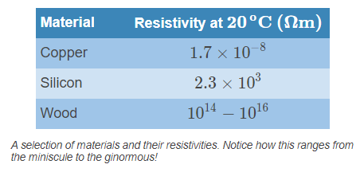
Resistivity is a measure of how much a material opposes current flow.
This is a property inherent to each material, and is a constant number. Although resistivity and resistance sound interchangeable, they refer to slightly different things. Resistivity is a property of the material that makes up a component or wire, while resistance is a property of the created component or wire.
Most metals have low resistivities because they contain free-moving, delocalised electrons; this is why they are used for circuit wiring, as low resistivities naturally result in a low resistance. Many non-metal objects, such as wood or clay, do not have delocalised electrons and have high resistivities.
When stating the resistivity of a material, we always state the temperature at which the resistivity was measured, because resistivity is temperature-dependent.

Slide 15
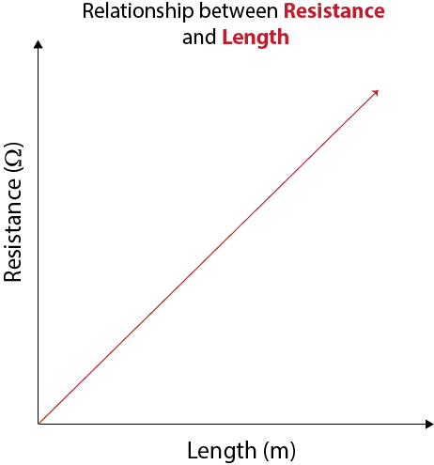
The length of the material displays a linearly proportional relationship with resistance.
R∝L . This means that when we use a longer object (say, a wire), its resistance increases at a fixed scale. On a graph, this would show a straight-line relationship.
What explains the maths behind this relationship? When the object is longer, the electrons making up the current have to travel further. They are far more likely to encounter an ion along the way.

Slide 16
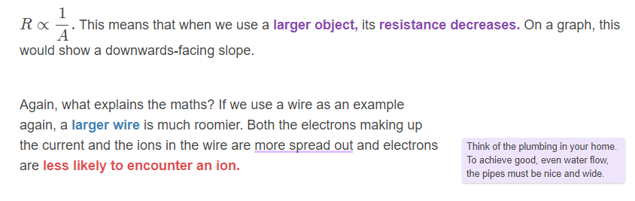
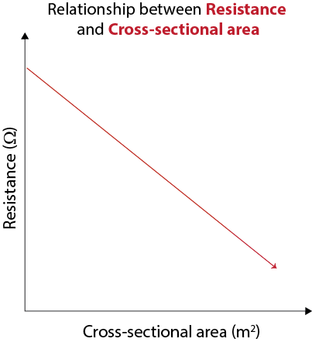
In contrast, the cross-sectional area of the material displays an inversely proportional relationship with resistance.
The cross-sectional area is a 2D area of a 3D object when it is cut perpendicular to an axis. In simpler terms, if you cut a carrot, its cross-sectional area would be the cut end.

Slide 17
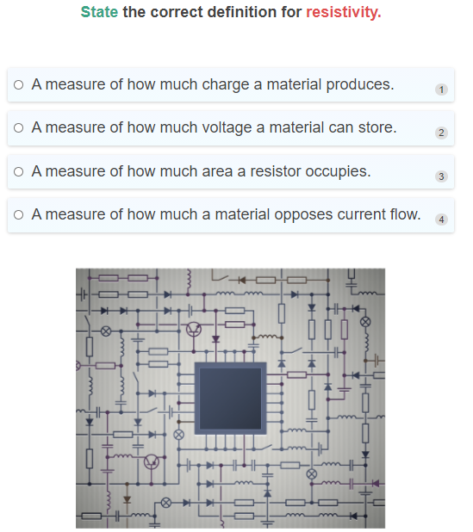

Slide 18
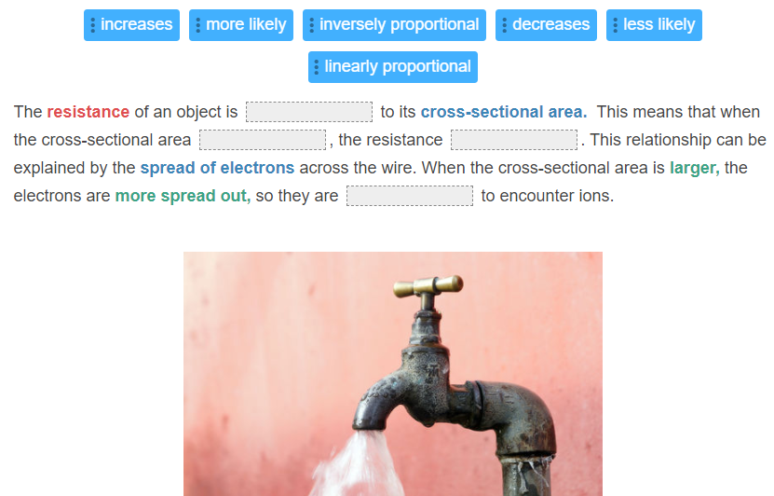

Slide 19
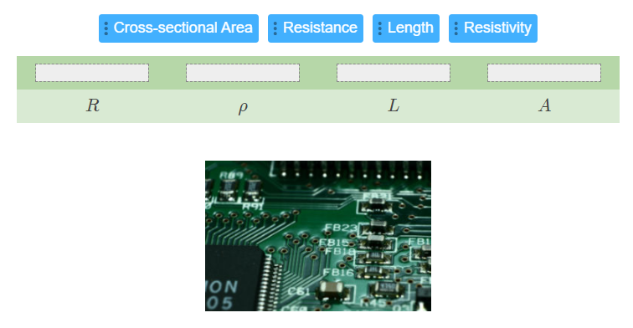

Slide 20
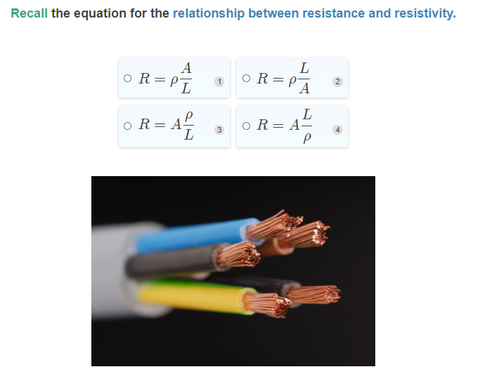

Slide 21
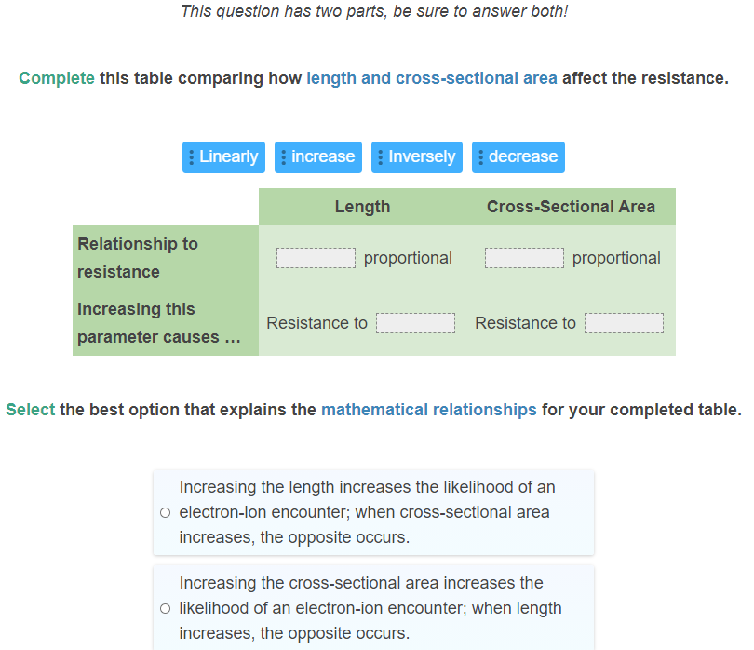

Slide 22
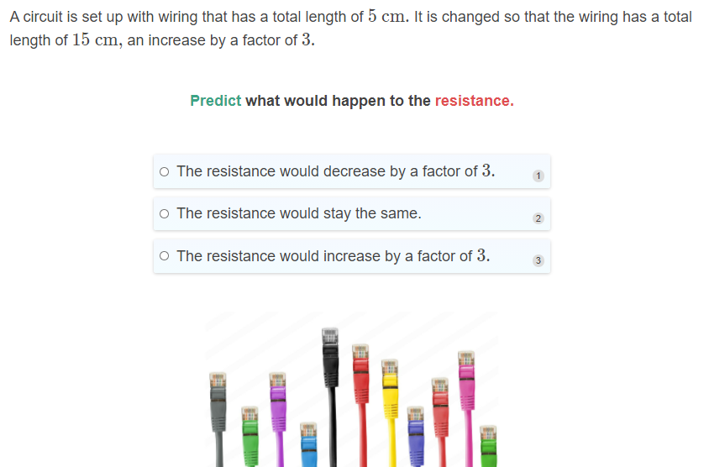

Slide 23
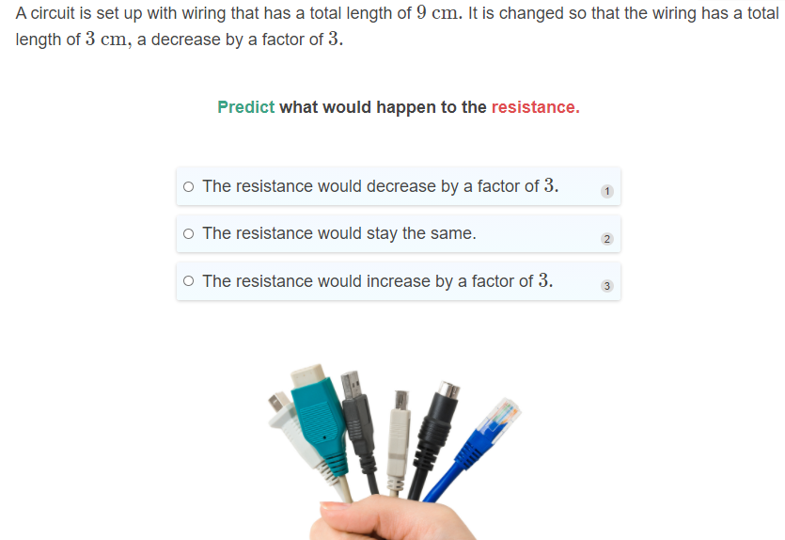

Slide 24


Slide 25
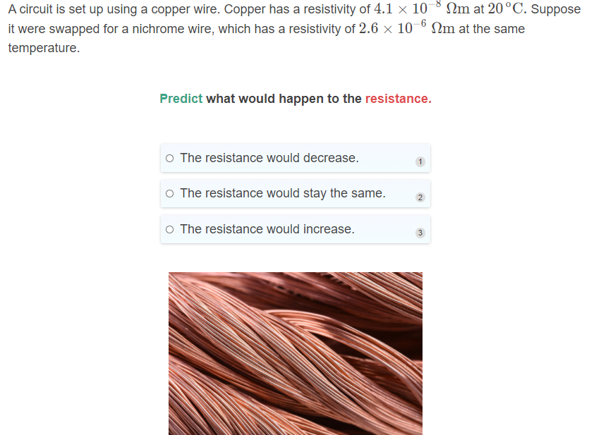

Slide 26
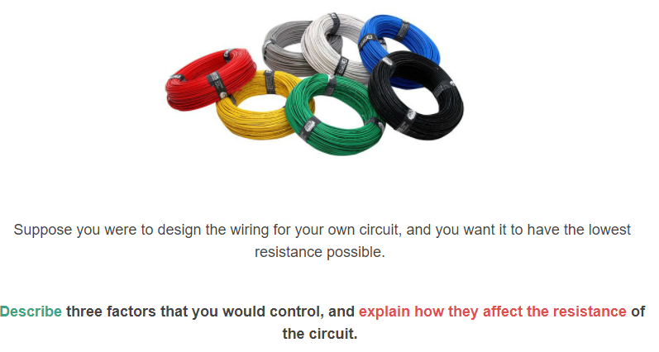

Slide 27
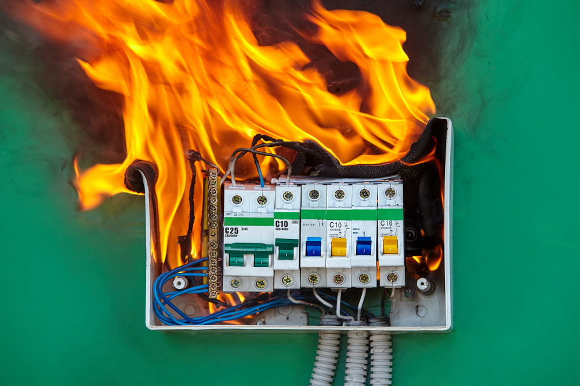
We’ve seen that for a circuit, we would want the wires to have a low resistance. In that case, why do we need resistors at all?
Many circuit components can only operate on low currents, and even burn out when the current is too high. In fact, high current is what causes an electrical overload, which can heat wires to the point of melting.
Unfortunately, we cannot directly change the current. However, by exploiting the relationship between voltage, current and resistance, we can indirectly control the current.

Slide 28

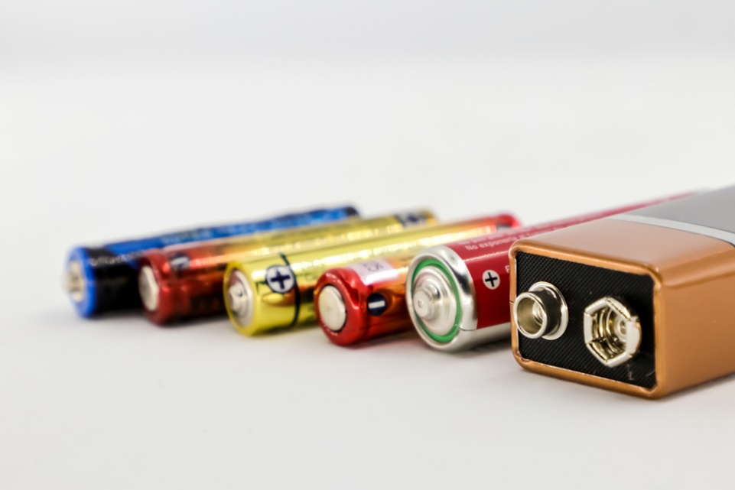
So if we want a small current, how could we manipulate the voltage or resistance? You now know what both relationships are, so you may already know what to do: decrease the voltage, or increase the resistance. We can do so by changing the battery and changing the resistor respectively.
In reality, there are only so many types of batteries that we can use, but we can use different resistors—even combinations of resistors—to limit the current.

Slide 29
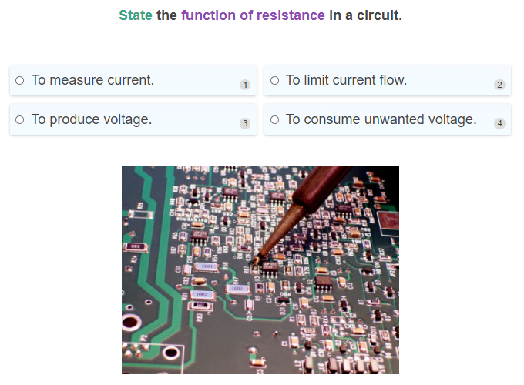

Slide 30
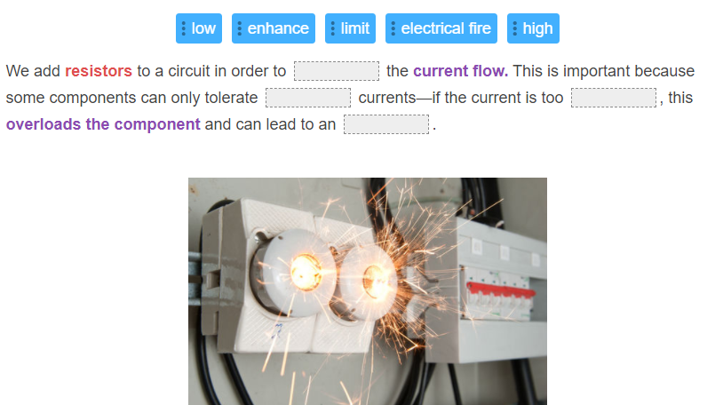

Slide 31
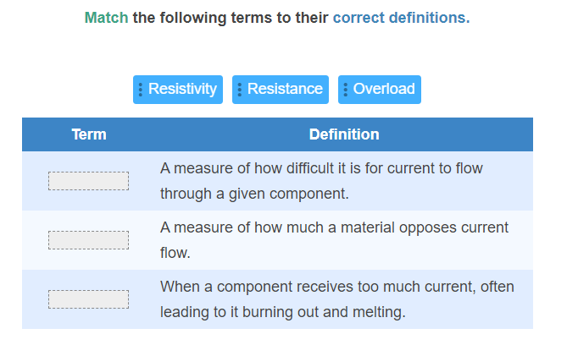

Slide 32
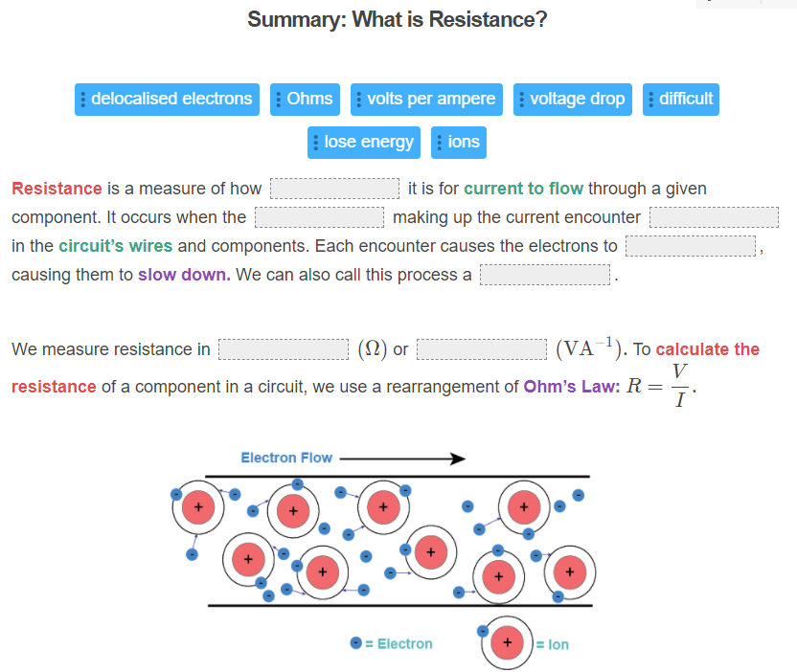

Slide 33
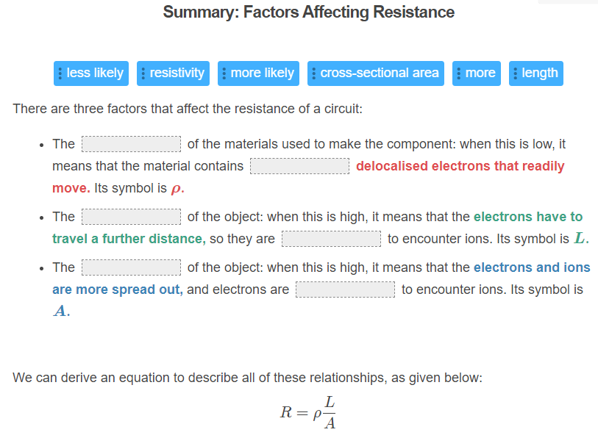

Slide 34
